Slide 1
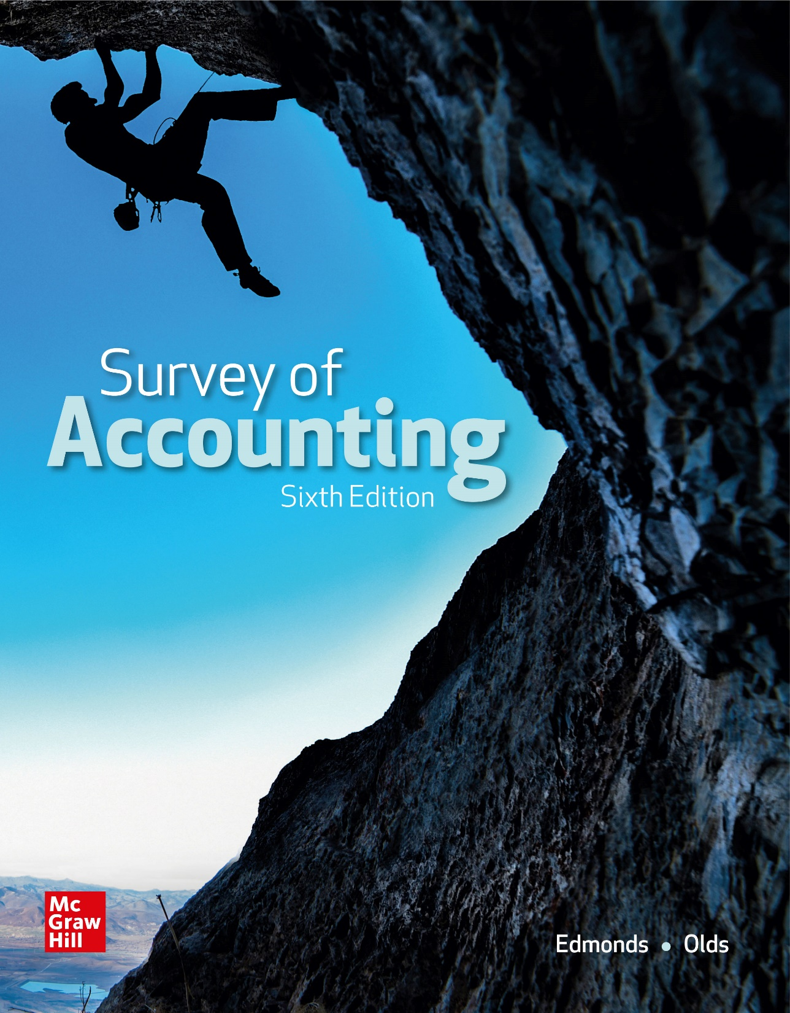
Chapter 5
Accounting for Receivables and Inventory Cost Flow

Slide 2
LO 5-1:
Use the percent of revenue method to account for uncollectible accounts expense.

Slide 3
Net Realizable Value of Accounts Receivable
Most companies do not expect to collect the full amount (face value) of their accounts receivable. Even carefully screened credit customers sometimes don’t pay their bills. The net realizable value of accounts receivable represents the amount of receivables a company estimates it will actually collect. The net realizable value is the face value less an allowance for doubtful accounts.

Slide 4
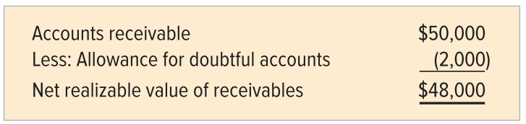
Allowance for Doubtful Accounts
The allowance for doubtful accounts represents a company’s estimate of the amount of uncollectible receivables. To illustrate, assume a company with total accounts receivable of $50,000 estimates that $2,000 will not be collected.

Slide 5
Allowance Method
Reporting accounts receivable at net realizable value is called the allowance method of accounting for uncollectible accounts.
The allowance method requires accountants to estimate the amount of uncollectible accounts.
One approach is to base the estimates on a percentage of revenue.

Slide 6
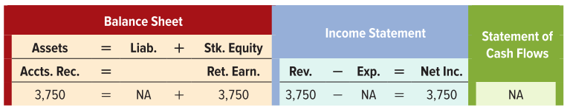
Accounting Events Affecting the Year 1 Period
Event 1 Revenue Recognition
Allen’s Tutoring Services (ATS) recognized $3,750 of service revenue earned on account during Year 1.

Slide 7
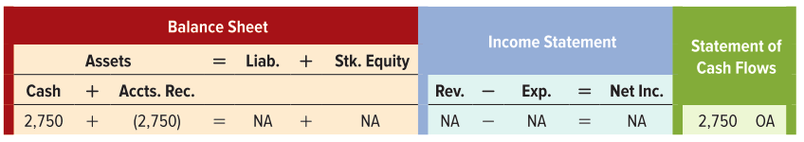
Accounting Events Affecting the Year 1 Period
Event 2 Collection of Receivables
ATS collected $2,750 cash from accounts receivable in Year 1.

Slide 8
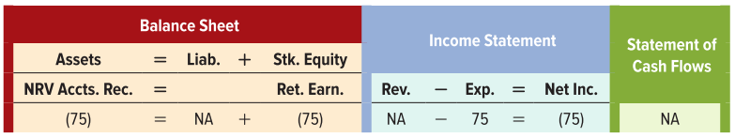
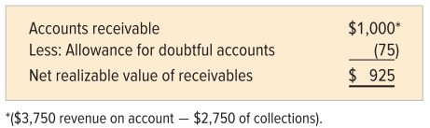
Accounting Events Affecting the Year 1 Period
Event 3 Recognizing Uncollectible Accounts Expense
ATS recognized uncollectible accounts expense for accounts expected to be uncollectible in the future. ATS would recognize $75 ($3,750 of revenue x 2%) on the Year 1 income statement.

Slide 9
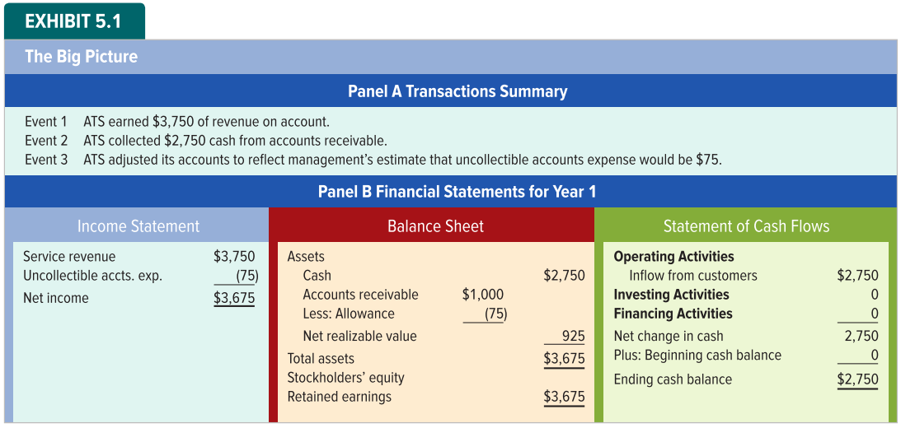
Analysis of Year 1 Financial Statements

Slide 10
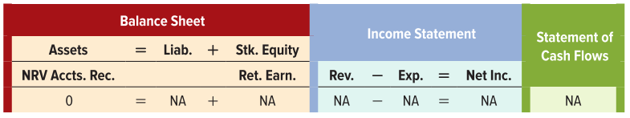
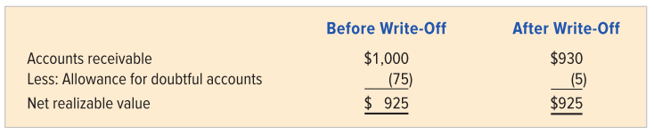
Accounting Events Affecting the Year 2 Period
Event 1 Write-Off of Uncollectible Accounts
ATS wrote off $70 of uncollectible accounts receivable

Slide 11
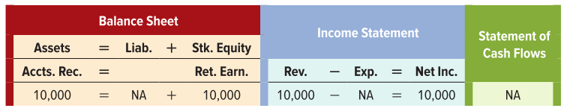
Accounting Events Affecting the Year 2 Period
Event 2 Revenue Recognition
ATS provided $10,000 of tutoring services on account during Year 2

Slide 12
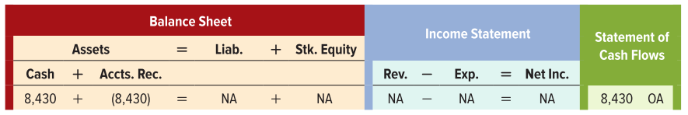
Accounting Events Affecting the Year 2 Period
Event 3 Collection of Accounts Receivable
ATS collected $8,430 cash from accounts receivable

Slide 13
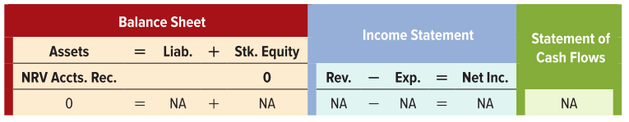
Accounting Events Affecting the Year 2 Period
Event 4 Recovery of an Uncollectible Account: Reinstate Receivable
ATS recovered a receivable that it had previously written off. This increases both Accounts Receivable and Allowance for Uncollectible Accounts, with zero effect on the NRV.

Slide 14
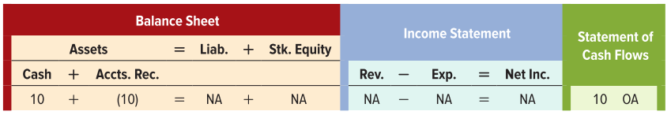
Accounting Events Affecting the Year 2 Period
Event 5 Recovery of an Uncollectible Account: Collection of Receivable
ATS recorded collection of the reinstated receivable.

Slide 15

Accounting Events Affecting the Year2 Period
Event 6 Adjustment for Recognition of Uncollectible Accounts Expense
Using the percent of revenue method, ATS recognized uncollectible accounts expense for Year 2
ATS will recognize $200 ($10,000 revenue x .02)

Slide 16
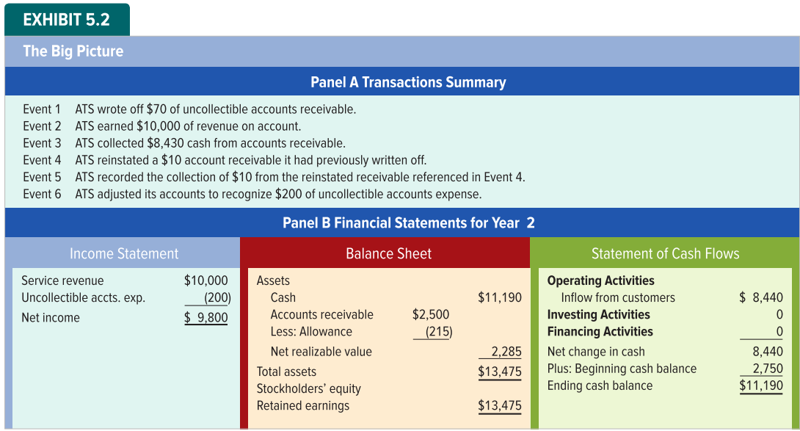
Analysis of the Year 2 Financial Statements

Slide 17
LO 5-2:
Use the percent of receivables method to estimate the uncollectible accounts expense.

Slide 18
Estimating Uncollectible Accounts Expense Using the Percent of Receivables Method
Some accountants believe they can better estimate the amount of uncollectible expense by basing their estimates on a percentage of accounts receivable rather than a percentage of revenue.
The approach focuses on estimating the most accurate balance for the Allowance for Doubtful Accounts account that appears on the year-end balance sheet.

Slide 19
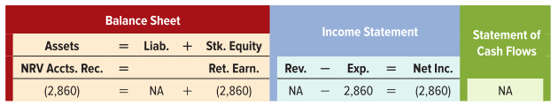
An Illustration of the Percent of Receivables Method
Before adjusting its accounts on Dec. 31, Year 1, Pyramid Corporation had a $56,000 balance in its Accounts Receivable account and a $500 credit balance in its Allowance for Doubtful Accounts account. Pyramid estimates that 6% of its accounts receivable are uncollectible.
Accounts receivable balance $56,000 × 6% = $3,360 Desired allowance
$3,360 - $500 balance in Allowance = $2,860 Uncollectible accounts expense

Slide 20
LO 5-3:
Use aging of accounts receivable to estimate the uncollectible accounts expense.

Slide 21
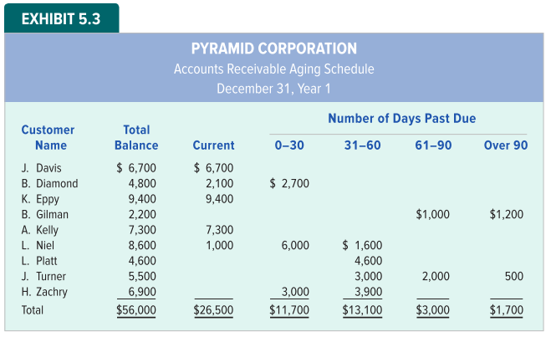
Accounts Receivable Aging Schedule

Slide 22
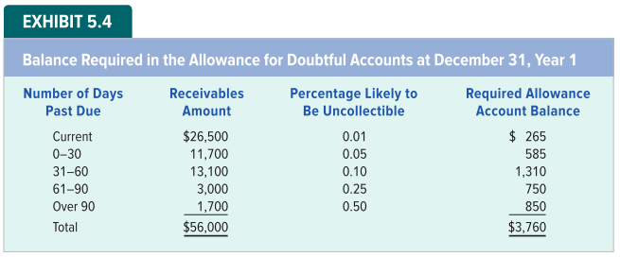
Balance Required in Allowance Account
The ending balance in the Allowance for Doubtful Accounts account shown must be $3,760. Since Pyramid has an unadjusted $500 balance in its Allowance account, the amount of uncollectible expense to be recognized is $3,260.

Slide 23
Matching Revenues and Expenses versus Asset Measurement
The percent of revenue method, with its focus on determining the uncollectible accounts expense, is often called the income statement approach.
The percent of receivables method, focused on determining the best estimate of the allowance balance, is often called the balance sheet approach.
Either approach provides acceptable results.

Slide 24
LO 5-4:
Show how accounting for notes receivable and accrued interest affects financial statements.

Slide 25
Accounting for Notes Receivable
Companies do not charge interest on accounts receivable that are not past due.
When a company extends credit for a long time or when the credit extended is large, the cost and the potential for disputes both increase.
The parties frequently enter into a credit agreement.
The terms are legally documented in a promissory note.

Slide 26
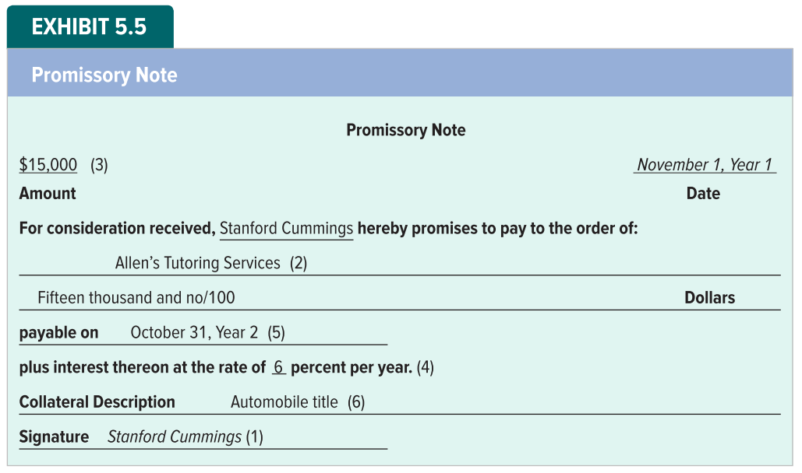
Promissory Note

Slide 27
Characteristics of Notes Receivable
Maker (also called borrower or debtor) - The person responsible for making payment on the due date.
Payee (also called creditor or lender) – The person to whom the note is made payable.
Principal – The amount of money loaned.
Interest – The economic benefit earned by the payee for loaning the principal
Maturity date – The date on which the maker must repay the principal and interest
Collateral – Assets that are assigned as security

Slide 28
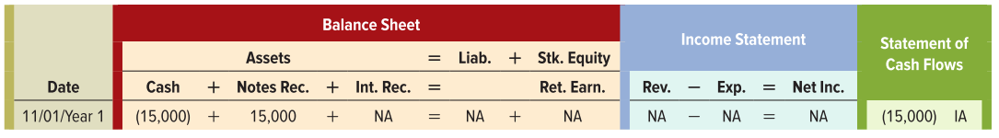
How Accounting for Notes Receivable Affects Financial Statements
Event 1 Loan of Money
ATS loaned $15,000 to Stanford Cummings on November 1, Year 1

Slide 29

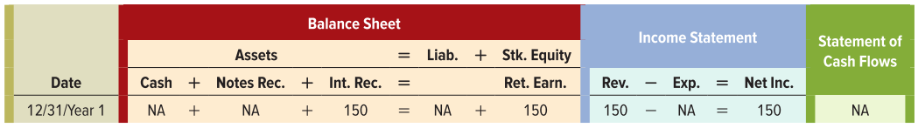
How Accounting for Notes Receivable Affects Financial Statements
Event 2 Accrual of Interest
Cummings will repay the principal ($15,000) plus interest of 6 percent of the principal amount (0.06 X $15,000 = $900) on October 31, Year 2.
ATS computed the amount of accrued interest

Slide 30


How Accounting for Notes Receivable Affects Financial Statements
Event 3 Collection of Principal and Interest
ATS collected $15,900 cash on the maturity date, including $15,000 for the principal plus $900 for the interest. ATS previously accrued interest for two months in Year 1. Since then, ATS has earned an additional 10 months of interest, computed and accrued as follows.

Slide 31
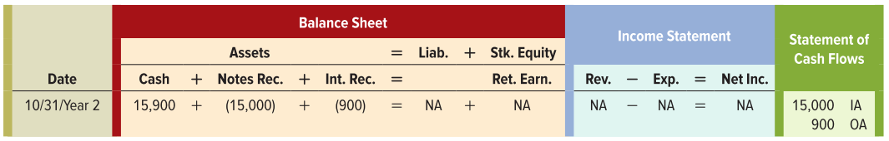
How Accounting for Notes Receivable Affects Financial Statements
Event 3 Collection of Principal and Interest
The total amount of accrued interest is now $900 ($150 accrued in Year 1 plus $750 accrued in Year 2) ATS collected $15,900 cash.

Slide 32
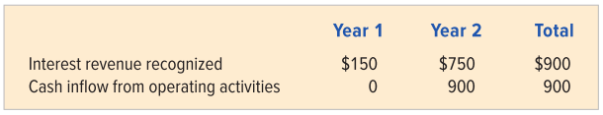
Financial Statements
The financial statements reveal key differences between the timing of revenue recognition and the exchange of cash.
Accrual accounting calls for recognizing revenue in the period in which it is earned regardless of when cash is collected.

Slide 33
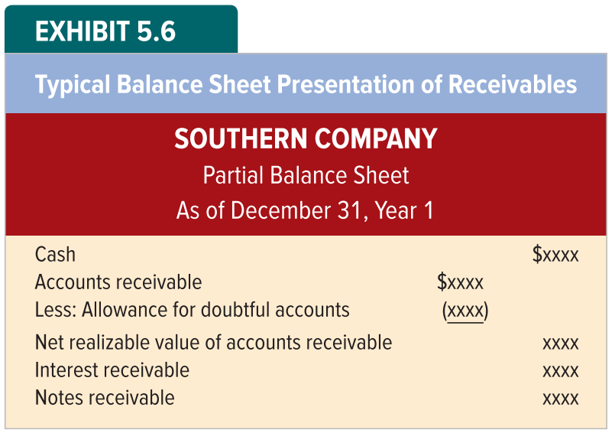
Typical Balance Sheet Presentation of Receivables

Slide 34
LO 5-5:
Show how accounting for credit card sales affects financial statements.

Slide 35
Accounting for Credit Card Sales
Rather than maintaining a credit granting department, many companies find it more efficient to accept credit cards. The credit card company deducts a fee, usually between 2% and 8%, from the gross amount of the sales and pays the merchant the net balance (gross sales less credit card fee) in cash.

Slide 36
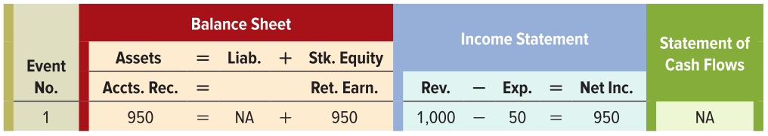
Accounting for Credit Card Sales
Event 1 Recognition of Revenue and Expense on Credit Card Sales
ATS accepts a credit card payment for $1,000 of services rendered. Assume the credit card company charges a 5 percent fee ($1,000 x 0.05 = $50).

Slide 37
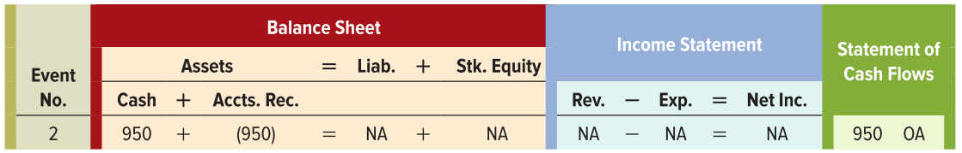
Accounting for Credit Card Sales
Event 2 Collection of Credit Card Receivable
The collection of the receivable due from the credit card company is recorded like any other receivable collection.

Slide 38
LO 5-6:
Show how different inventory cost flow methods (specific identification, FIFO, LIFO, and weighted average) affect financial statements.

Slide 39
Inventory Cost Flow Methods
Businesses often pay different amounts for identical inventory items
Suppose the Mountain Bike Company (TMBC) purchases one helmet at a cost of $100 and a second helmet at a cost of $110.
If TMBC sells one of its helmets, should it record $100 or $110 as cost of goods sold?
Four acceptable methods for determining the cost are (1) specific identification; (2) first-in, first-out (FIFO); (3) last-in, first-out (LIFO); and (4) weighted average

Slide 40
Specific Identification
Suppose TMBC tags inventory items so that it can identify which one is sold at the time of sale.
Using specific identification, cost of goods sold would be $100 if the first item purchased were sold or $110 if the second item purchased were sold.

Slide 41
Specific Identification Disadvantages
When a company’s inventory consists of many low-priced, high-turnover goods, the record keeping necessary to use specific identification isn’t practical.
Another disadvantage of the specific identification method is the opportunity for managers to manipulate the income statement. TMBC can report a lower cost of goods sold by selling the first instead of the second item.

Slide 42
First-In, First-Out (FIFO)
The first-in, first-out (FIFO) cost flow method requires that the cost of the items purchased first be assigned to cost of goods sold. Using FIFO, TMBC’s cost of goods sold is $100.

Slide 43
Last-In, First-Out (LIFO)
The last-in, first-out cost flow method requires that the cost of the items purchased last be assigned to cost of goods sold. Using FIFO, TMBC’s cost of goods sold is $110.

Slide 44
Weighted Average
To use the weighted average cost flow method, first calculate the average cost per unit by dividing the total cost of the inventory available by the total number of units available.
In the case of TMBC, the average cost per unit is $105 [($100 + $110) ÷ 2]
Cost of goods sold is calculated by multiplying the average cost per unit by the number of units sold
TMBC’s cost of goods sold is $105 ($105 x 1)

Slide 45
Physical Flow
Our discussions about inventory cost flow methods pertain to the flow of costs through the accounting records, not the actual physical flow of goods.
Cost flows can be done on a different basis than physical flow.

Slide 46
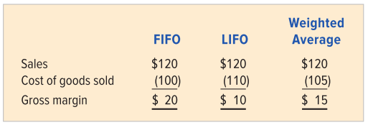
Effect of Cost Flow on the Income Statement
The cost flow method a company uses can significantly affect the gross margin reported in the income statement.

Slide 47
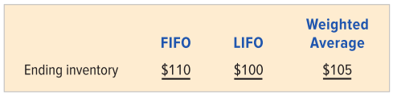
Effect of Cost Flow on the Balance Sheet
Since total product costs are allocated between cost of goods sold and ending inventory, the cost flow method used affects its balance sheet as well as its income statement.

Slide 48
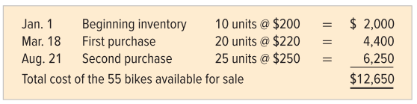
Multiple Layers with Multiple Quantities
The following information relates to TMBC’s Eraser bike.
TMBC paid cash for all bike purchases and sold 43 bikes at a cash price of $350 each

Slide 49
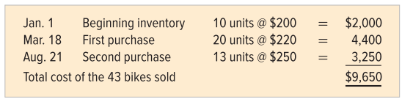
FIFO Cost of Goods Sold
TMBC sold 43 Eraser bikes. The FIFO method transfers to the Cost of Goods Sold account the cost of the first 43 bikes TMBC had available to sell. The expense recognized for the cost is computed as follows:

Slide 50
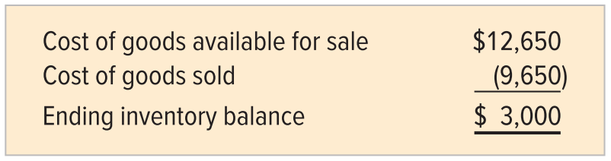
FIFO Ending Inventory
TMBC had 55 bikes available and sold 43. It would have 12 bikes in ending inventory. The cost assigned equals the cost of goods available for sale minus the cost of goods sold.

Slide 51
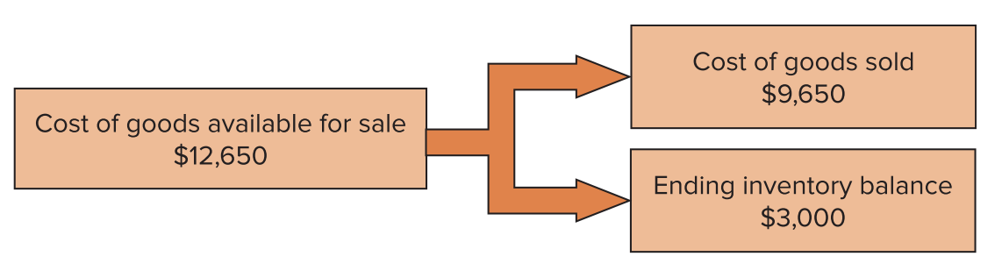
Allocation of Cost of Goods Available for Sale
The FIFO allocation of the cost of goods available for sale between cost of goods sold and ending inventory is shown graphically here:

Slide 52
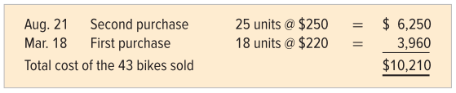
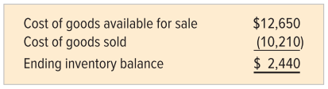
LIFO Inventory Cost Flow
Under LIFO, the cost of goods sold is the cost of the last 43 bikes acquired by TMBC.
The LIFO cost of the 12 bikes in ending inventory is computed as follows:

Slide 53
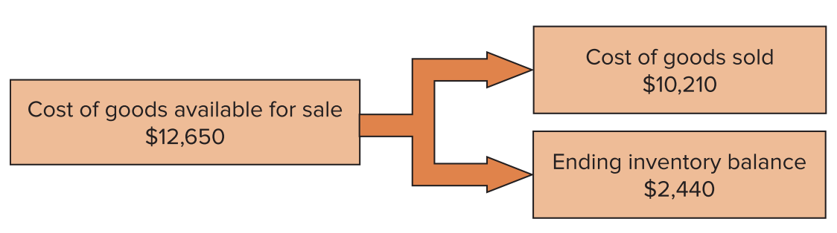
Allocation of Cost of Goods Available for Sale
The LIFO allocation of the cost of goods available for sale between cost of goods sold and ending inventory is shown graphically here:

Slide 54
Weighted-Average Cost Flow
The weighted-average cost per unit is determined by dividing the total cost of goods available for sale by the total number of units available for sale.
For TMBC, the weighted-average cost per unit is $230 ($12,650 ÷ 55). The cost of goods sold is $9,890 ($230 x 43).
The cost assigned to the 12 bikes in ending inventory is $2,760 (12 x $230).

Slide 55
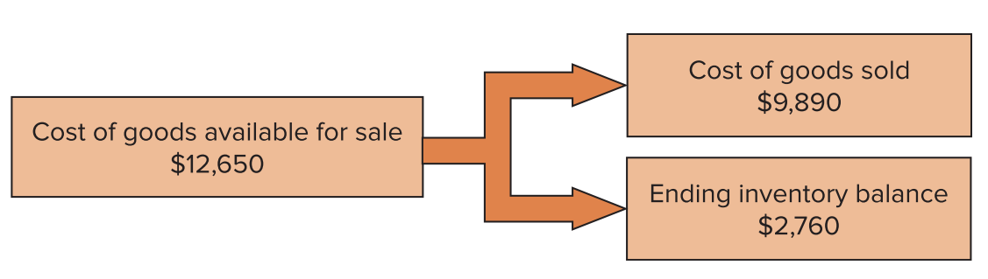
Allocation of Cost of Goods Available for Sale
The weighted-average allocation of the cost of goods available for sale between cost of goods sold and ending inventory is shown graphically here:

Slide 56
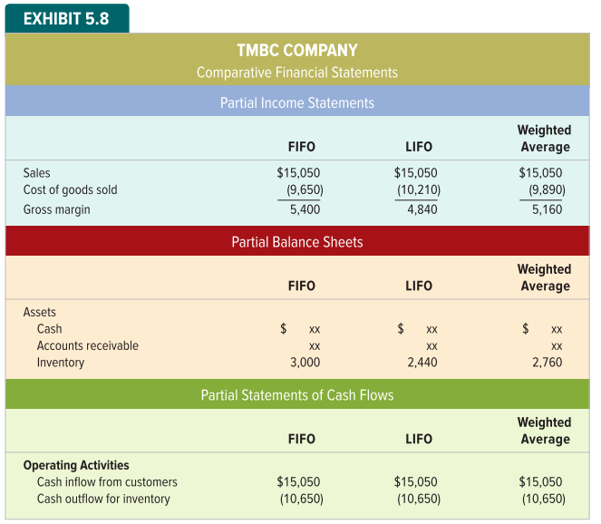
Effect of Cost Flow on Financial Statements

Slide 57
End of Chapter 5

